Slide 1
International Licensing Service
Fulfilling legal demands in NPP construction and operation
ATOMEX-Europe, 25-26 October, 2011
Dr. Wolfgang Zehtner, TÜV SÜD Group

Slide 2
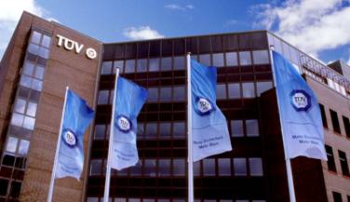
TÜV SÜD – The Company
Facts and Figures
Technical service provider
16,000 staff (2010)
Over 600 locations worldwide
Sales revenue in 2010: Euro 1,552 million
Headquarters: Munich (Germany)
Regions: Western Europe, Central Eastern Europe, Middle East/Africa, Asia-Pacific and Americas
Over 140 years of business success

Slide 3
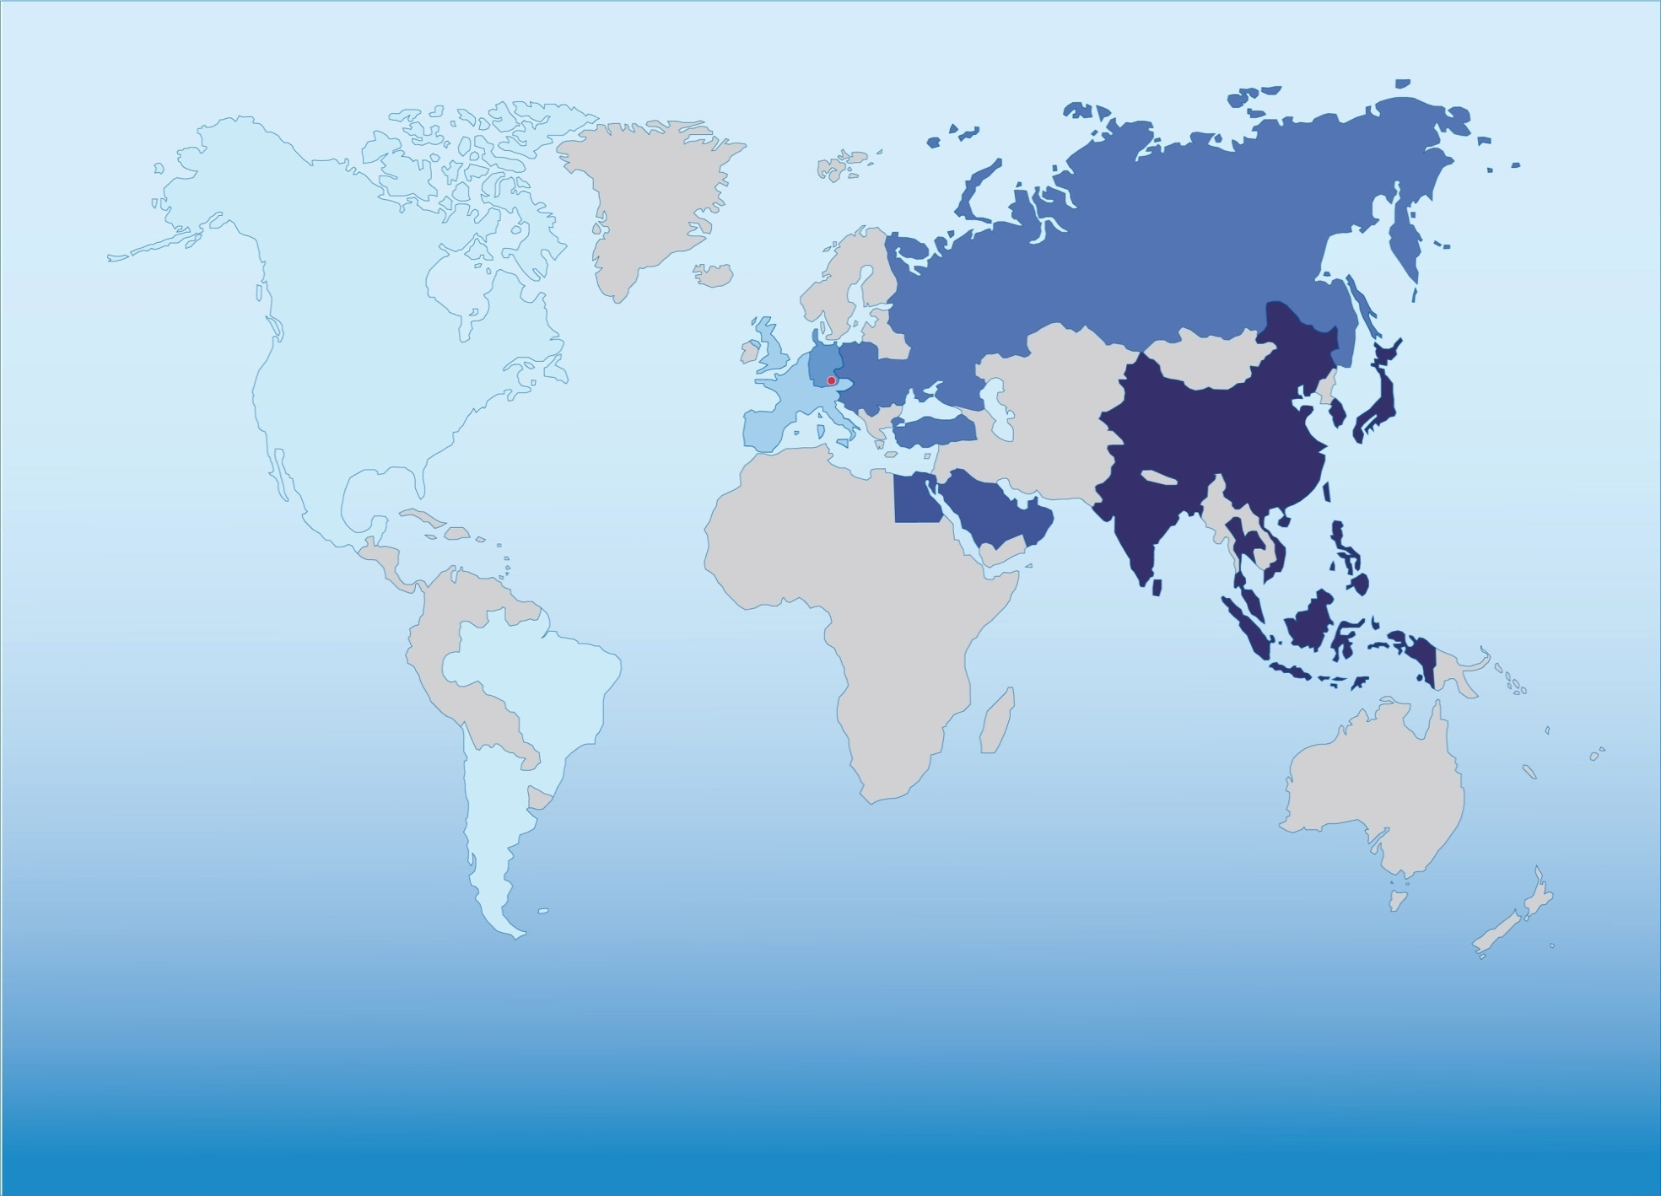
Global Presence
AMERICA
Euro 79 m^{*)}
WESTERN EUROPE
Euro 129 m ^{*)}
GERMANY
Euro 1,005 m ^{*)}
CENTRAL &
EASTERN-EUROPE
Euro 55 m ^{*)}
MIDDLE EAST/
AFRICA
Euro 9 m ^{*)}
ASIA PACIFIC
Euro 150 m ^{*)}
*) sales revenue in 2009

Slide 4
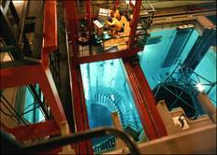
Introduction to TÜV SÜD
What we provide:
Regulatory Support and Engineering Consultancy
INDUSTRY
MOBILITY
CERTIFICATION
Civil Engineering
Lifts and Machinery
Electrical & Building Services Engineering
Plant Engineering
Steam & Pressure Engineering
Environmental Engineering
&
Nuclear Engineering
Nuclear Engineering
Reactor Assessment, Consultation Services, Testing and Inspection of NPPs, Radiation Protection, Waste Management
4

Slide 5
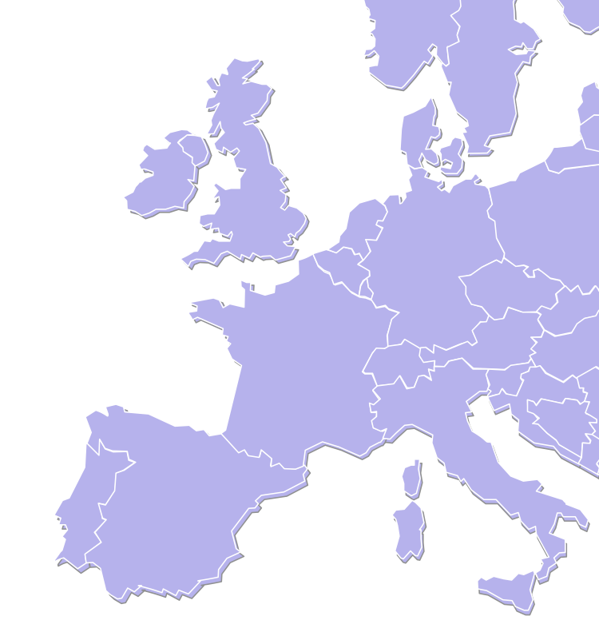
TÜV SÜD Nuclear Activities
Europe & Asia
1000 Science and Engineering Staff
Over 50 years of Nuclear Industry experience of long-standing customer relationships with German nuclear power plant operators
Work with all Nuclear Power Plants in operation and also with the 6 under construction (+ OL3)
Primary provider of services in the area and quality assurance inspection of NPPs and components in Germany and Korea
Experience with all areas of Nuclear Industry
Quality management system based on DIN ISO 9001
Dounreay
Sellafield
Warrington
Harwell
Gloucester
Winfrith
Mannheim
Stuttgart
Munich
5

Slide 6
TÜV SÜD Nuclear Activities
TÜV SÜD Czech is an authorized body according to regulation No. 309/2005 Coll.
As authorized body AO 211 TÜV SÜD considers in the Czech republic the conformity of special-designed equipments for nuclear energy, which conforms to regulation No. 309/2005 Coll.
As inspection body No. 4002 according to ISO/IEC 17020, TÜV SÜD inspects equipment and technology for nuclear energy.
TÜV SÜD Czech take a part in building of 3. and 4. block of nuclear power station Mochovce

Slide 7
TÜV SÜD Nuclear Activities
TÜV SÜD Czech
Main field of activities are inspections by suppliers of classic and nuclear power stations, operation, reconstruction and modernization of nuclear power stations in the Czech republic, inspections by producers of basic and additional material for nuclear power station.
Checking of production and management systems from independent third party and helping of increasing of the level of suppliers for nuclear power station.
Fulfilling of czech legal requirements for launching of special-designed equipments for nuclear energy.

Slide 8
Regulatory Authorities
TÜV SÜD Nuclear Activities
Sample of TÜV SÜD Clients (1)
Utilities & Suppliers
Autoridad Regulatoria Nuclear (ARN), Buenos Aires, Argentina
ENSI / HSK, Switzerland
German Federal Office for Radiation Protection (BfS)
German Nuclear Authorities and Ministries in Bavaria, Baden-Württemberg, Hessian, Schleswig-Holstein
Health and Safety Executive – HSE (UK)
European Union – EU
National Nuclear Regulator (NNR), Republic of South Africa (RSA)
Consejo de Seguridad – CSN (Spain)
AREVA NP
British Energy
EdF
Korea: Electric Power Research Institute & Hydro and Nuclear Power (KHNP)
RWE POWER AG, Essen
Siemens
Swiss Nuclear Power Plants: Gösgen & Leibstadt
Teollisuuden Voima OYJ (TVO)

Slide 9
Regulatory Authorities and Technical Support Organisations
TÜV SÜD Nuclear Activities
Sample of TÜV SÜD Clients (2)
Utilities & Suppliers
Russian Nuclear Regulatory Authority
Ukrainian Nuclear Regulatory Authority
Ukrainian State Scientific and Technical Centre for Nuclear and Radiation Safety
VO Safety (TSO)
Zarubyezhatomenergostroy (TSO)
ANO Atomcertifica (Certification body)
ANO Atomtekhnotest (Certification body)
Atomenergoproekt, Moskau
Atomenergoproekt, Nizhniy Novgorod
OKBM Gidropress, Podolsk
Rosatom
Rosenergoatom
PKF of Rosenergoatom
Atomenergostroy

Slide 10
TÜV SÜD Nuclear Activities
Sample of TÜV SÜD Work for Russian and Ukrainian Clients
Trainings and Workshops on new developments in the field of quality and safety management, safety assessments and safety requirements for all clients
Safety Assessments and Evaluations of New Fuel Assemblies and Reactor Core Reloadings for VVER-Reactor (440/1000)
Verification and Validation of Data libraries and Codes for 3D kinetic and static reactor core calculations
Information exchange on New digital IT & IC Systems for Nuclear Power Plants
Certification Tests of data base software application for core parameter monitoring system in the framework of the system certification (ANO Atomcertifica)
Workshops on safety aspects and practical experiences in the framework of decommissioning of Nuclear Power plants in Europe (Germany and UK) for Rostekhnadzor
Management System Certification for all clients
Safety Assessments and Support to the Russian and Ukraine Regulatory Authority during licensing of equipment delivery in the framework of TACIS Modernisation projects for Rosenergoatom and Energoatom Ukraine (safety relief valves, drives, monitoring systems etc.)
Comparative Analysis of the Main Generation III+ New Build Projects (EPR, VVER-1000 and 1200 etc.)
Development of recommendations for Conformity assessment of products for Ukraine Nuclear Operator Energoatom

Slide 11
International Licensing Services
TÜV SÜD offers consulting to companies in the international nuclear sector concerning approval before filing of application
Discovering nonconformities at the earliest state saves time and money
Country-specific analysis of rules and approval procedures
Investigation of demands
Coordination with public authorities
Generation / testing of approval documents

Slide 12
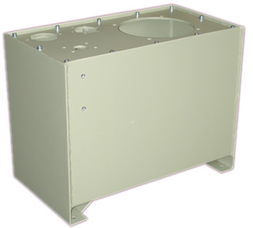
Licensing of NPP SSCs
In NPPs, Systems, Structures and Components (SSC) are classified according to their safety relevance
Example:
Reactor pressure vessel, highest safety class: High demands on leak-tightness, corrosion, radiation resistance, monitoring systems, etc. → regulation in specific nuclear standards
Turbine oil tank, minor safety class: no relevance for nuclear safety or radiation protection → specific nuclear standards do not apply → conventional standards will apply

Slide 13
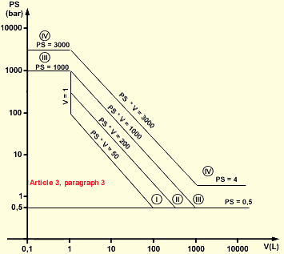
Licensing of non-nuclear SSCs
Non-nuclear SSCs may be relevant for plant availability
Turbine oil tank, minor safety class but relevant for turbine operation
→ conventional standards (EU: CE-Conformity) will apply → additional precautions in respect to plant availability may be appropriate
TÜV SÜD investigated the demands of the conventional standards in EU. For example:
Pressure equipment directive
Machinery directive
Low voltage directive
EMC standards
For the turbine island of a modern PWR, TÜV SÜD also investigated appropriate additional precautions in respect to plant availability and anticipated customer demands

Slide 14
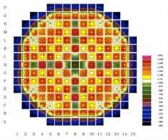
Licensing of safety-relevant SSCs
TÜV SÜD has accompanied construction, operation and dismantling of nuclear power plants in Germany.
For German NPPs in operation, TÜV SÜD conducts:
Modification procedures
Periodic tests
Site inspections
Content maintenance of the German nuclear directives

Slide 15
Summary – What we offer
TÜV SÜD conducts CE-Conformity tests as Notified Body (NoBo)
TÜV SÜD offers consulting services for ASME and KTA rules
TÜV ENERGIE CONSULT is accredited to “Atomsertifica” as test laboratory for nuclear appliances

Slide 16
Summary – Value for our Client
Interdisciplinary and intergral services - practice oriented and theoretically competent
Third party organisaiton – neutral and independent
Non-manufacturer, non-seller, non-buyer, non-operator
Longstanding experience
Experience in all international codes and standards
Extensive pool of experts covering all aspects of nuclear technology
German quality standards
Local presence

Slide 17
TÜV SÜD Group
Choose certainty. Add value.
wolfgang.zehtner@tuev-sued.de
www.tuev-sued.de

